Slide 1
Canadian Union of Public Employees
CUPE
PRESENTED TO:
RIVER EAST TRANSCONA EDUCATIONAL ASSISTANTS ASSOCIATION (RETEAA)
SM/jca/Cope 491

Slide 2

LAND ACKNOWLEDGEMENT
“We wish to acknowledge that we are gathered on Treaty 1 Territory, the traditional territory, and ancestral lands of the Anishinaabeg, Cree,
Oji-Cree, Dakota, and Dene Peoples, and on the National Homeland of the Red River Métis.”

Slide 3

K-12 AND CUPE
CUPE Manitoba’s Education Sector
More than half of all education workers across Canada are CUPE members.
The Manitoba K-12 Education sector is made up of 45 locals, approximately 6,100 members.
CUPE represents over 140,000 workers in elementary and secondary schools across Canada, in every classification in the school system - except teachers and management – in over 400 education bargaining units.
CUPE’s Education Sector remains one of the strongest in Canada.

Slide 4
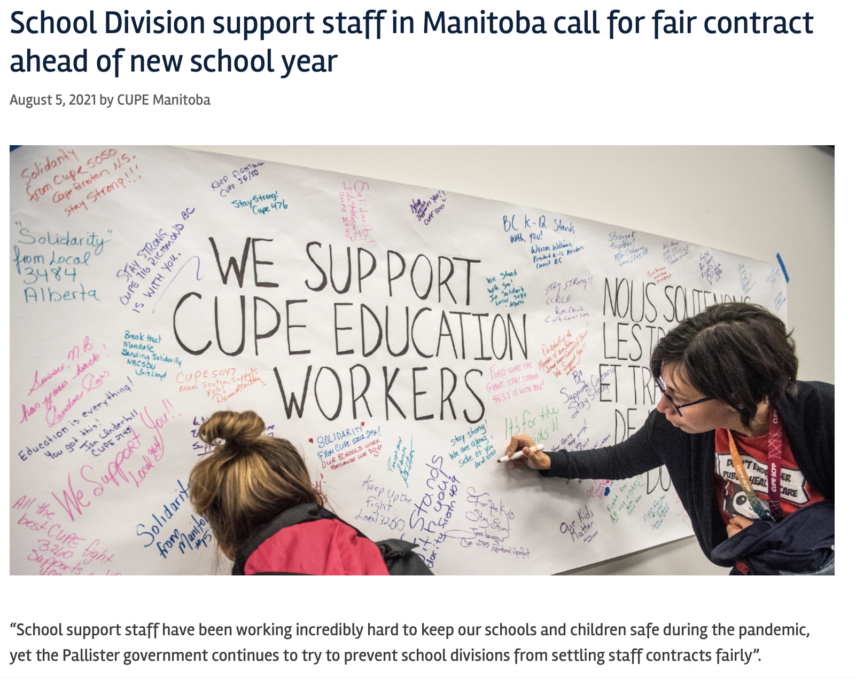

Slide 5
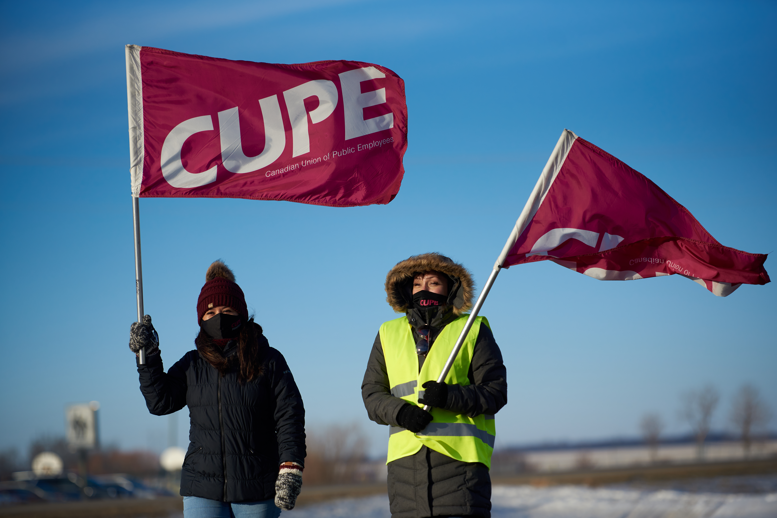
CUPE staff supporting K-12 workers on the picket line in Manitoba, 2022

Slide 6
CUPE NATIONAL REPRESENTATIVES
Each local is assigned a National Representative.
The CUPE National Representative:
advises and assists locals with day-to-day labour relations including grievance handling and labour/management meetings;
has access to specialist support in the province and Ottawa for things like arbitrations, negotiations, research, communications, health and safety, etc.
(e.g. campaigns, cost-shares, strike and defense funds);
provides support and training for local memberships (conflict resolution, financial, bullying and harassment, etc.); and
assists and supports with local executive and membership meetings.

Slide 7
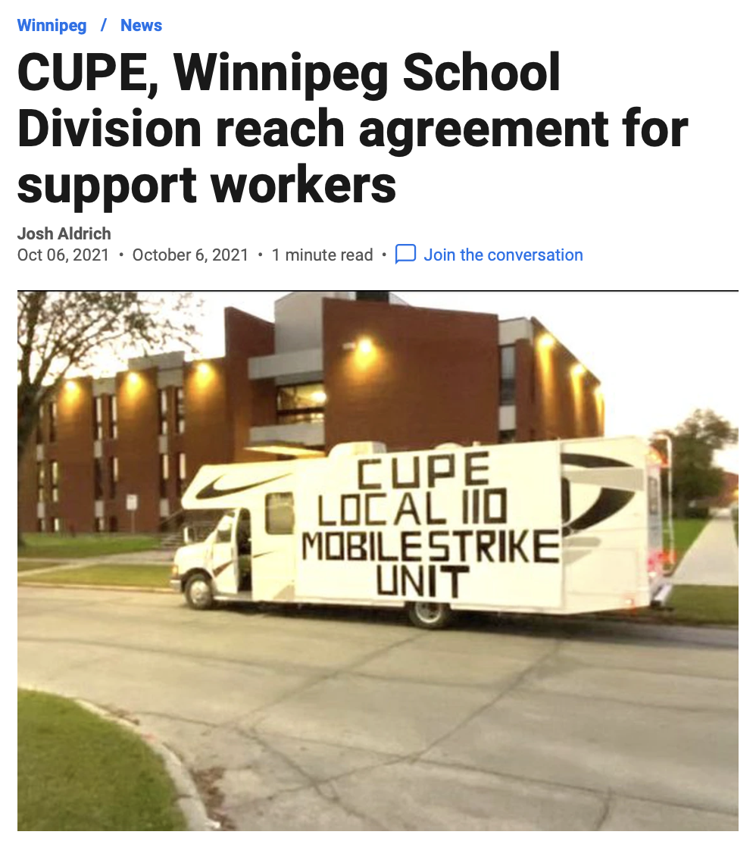


Slide 8
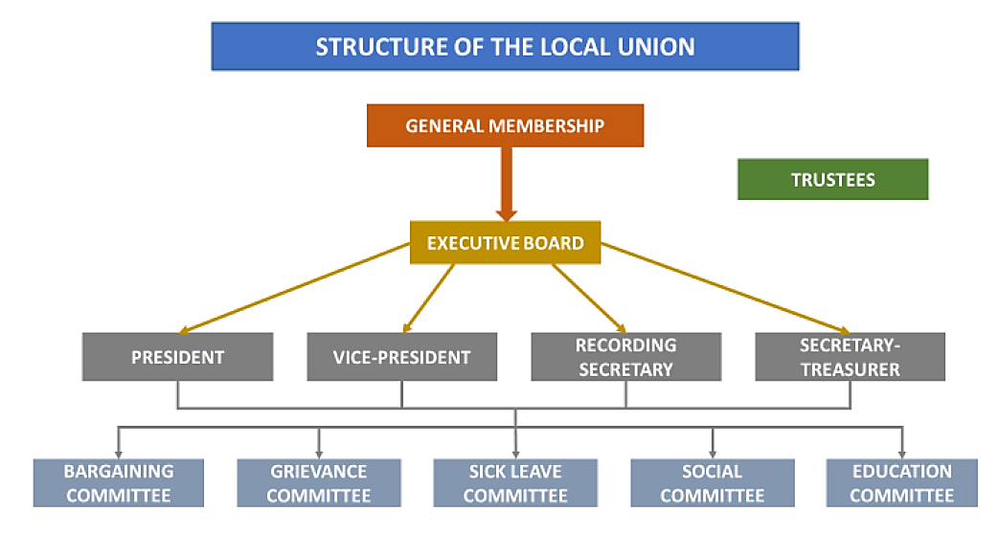
LOCAL CUPE STRUCTURE

Slide 9
CUPE STRUCTURE
LOCAL AUTONOMY
CUPE has a structure, in which each local elects its own Executive, sets its own dues structure, conducts its own bargaining and strike votes, and sends delegates to Division and National conventions to form overarching policy. This system places the power in the hands of the employees - where it belongs.
CUPE locals are affiliated directly with the National body, and affiliation with Provincial CUPE bodies is optional.
CUPE National provides their locals with support and assistance through National Representatives, who are employees of CUPE National.

Slide 10
UNION DUES
Based on regular hours worked
Union dues are set by the local
Of that:
  .85% of the dues goes to National
  Any balance remains within the local

Slide 11
STRIKE INFORMATION
No worker could survive a strike or a lockout without strike pay.
Union dues help workers create a National Strike Fund and allow workers to fight back on a more level playing field with their employer.
CUPE’s strike fund is over $130 million.

